Slide 1
Arithmetic
Dr. Rajib Ranjan Maiti
CSIS, BITS-Pilani, Hyderabad
Disclaimer: To know the complete syllabus, handout and the text book should be consulted

Slide 2
Addition and Subtraction
Overflow
occurs when the result from an operation cannot be represented with the available hardware
in this case, a 32-bit word
Basic idea
c - a = c + (-a)
MIPS detects
overflow with an exception, also called an interrupt on many computers
MIPS includes
a register called the exception program counter (EPC) to contain the address of the instruction that caused the exception
The instruction move from coprocessor 0 (mfc0) is used to copy EPC into a general-purpose register so that MIPS software has the option of returning to the offending instruction via a jump register instruction, e.g., mfc0 $t0, $14 #register 14 in c0
Operation | Operand A | Operand B | Result indicating overflow | Example (4 bit signed)
A + B | ≥ 0 | ≥ 0 | < 0 | 0111 + 0111 = 1110
A + B | < 0 | < 0 | ≥ 0 | 1010 + 1010 = 0100
A - B | ≥ 0 | < 0 | < 0
A – B | < 0 | ≥ 0 | ≥ 0

Slide 3
Registers in c0
The exception mechanism in MIPS is implemented by the coprocessor 0 which is always present
Coprocessor 1 implements floating operations and need not be present always
User programs run in user mode.
The CPU enters the kernel mode when an exception happens.
Thus, Coprocessor 0 can only be used in kernel mode.
The whole upper half of the memory space is reserved for the kernel mode:
it can not be accessed in user mode
Instructions which access the registers of coprocessor 0
mfc0 Rdest, C0src #Move the content of coprocessor’s register C0src to Rdest
mtc0 Rsrc, C0dest #Integer register Rsrc is moved to coprocessor’s register C0dest
lwc0 C0dest, address #Load word from address in register C0dest
swc0 C0src, address #Store the content of register C0src at address in memory
Exception handling registers in coprocessor 0
8 BadVAddr Memory address where exception occurred
12 Status Interrupt mask, enable bits, and status when exception occurred
13 Cause Type of exception and pending interrupt bits
14 EPC Address of instruction that caused exception

Slide 4
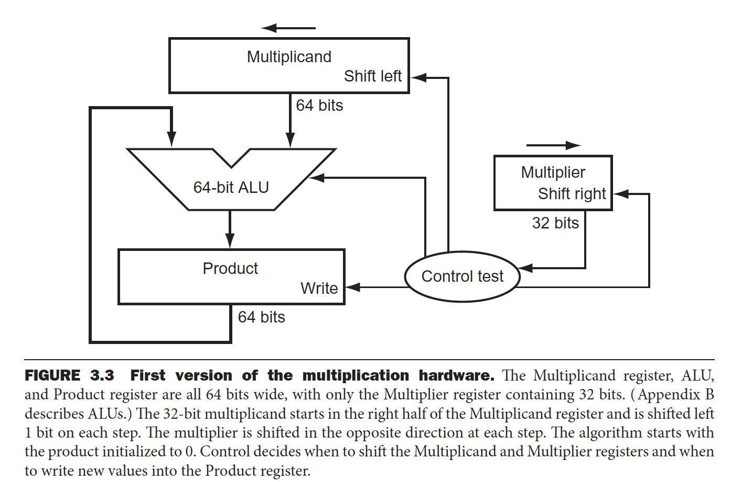
Multiplication in MIPS
MIPS provides
a separate pair of 32-bit registers to hold 64-bit product: Hi and Lo.
To produce a properly signed or unsigned product, MIPS has two instructions:
multiply (mult) and multiply unsigned (multu)
mult $t2, $t3 #[hi, lo] <- $t2 * $t3
To fetch the integer 32-bit product, the programmer uses two pseudoinstructions to place the product into registers
move from lo (mflo)
move from hi (mfhi)
mflo $t1
mfhi $t0

Slide 5
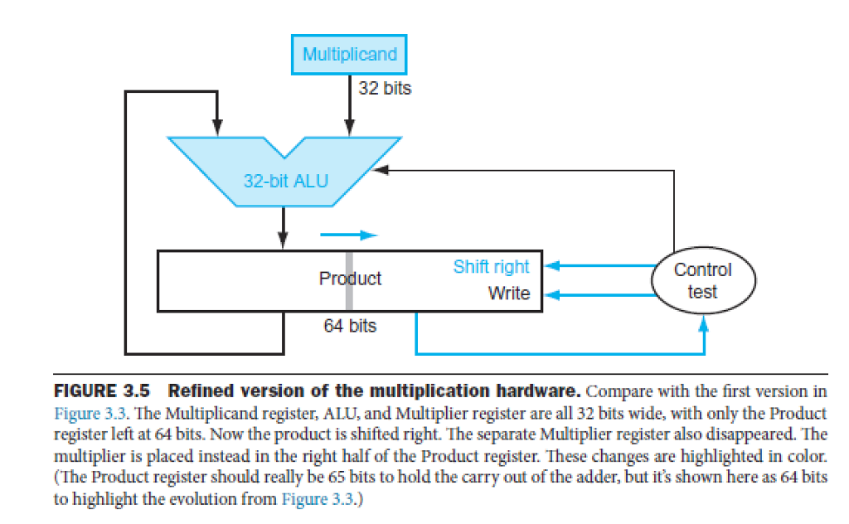
Improved Multiplication Circuit

Slide 6
Division
The one complication of signed division is that we must also set the sign of the remainder. Remember that the following equation must always hold:
Dividend = Quotient X Divisor + Remainder
Lets consider the cases of dividing all the combinations of ±7_{ten} by ±2_{ten}
The first case:
+7 ÷ +2 ➔ Quotient = +3, Remainder = +1
Checking the results:
+7 = 3 x 2 + (+1) = 6 + 1
The second case:
-7 ÷ +2 ➔ Quotient = -3
Checking the result:
Remainder = (Dividend X Quotient - Divisor)
= -7 - (-3 x +2)
= -7 - (-6) = -1
So, -7 ÷ +2 ➔ Quotient = -3, Remainder = -1
Checking the results again:
-7 = -3 x 2 + (-1) = -6 -1
We calculate the other combinations by following the same rule:
-7 ÷ -2 ➔ Quotient = 3, Remainder = -1
+7 ÷ -2 ➔ Quotient = -3, Remainder = 1

Slide 7
Floating Point

Slide 8
Floating Point
IEEE 754 floating-point standard
floating-point numbers are of the form
(-1)^{s} x F x 2E
IEEE 754 uses a bias of +127 for single precision,
so an exponent of -1 is represented by the bit pattern of the value -1 + 127_{ten}, = 126_{ten} = 0111 1110_{two},
and 1 is represented by 1 + 127 = 128_{ten} = 1000 0000_{two} .
Biased exponent means that the value represented by a floating-point number is really
(1)^{S} x (1 + Fraction) x 2^{(Exponent - Bias)}
Smallest value
±1.0000 0000 0000 0000 0000 000_{two} x 2⁻¹²⁶
Largest value
±1.1111 1111 1111 1111 1111 111_{two} x 2¹²⁷
all 0 bits in the exponent ➔reserved and indicates floating-point representation of zero
31 | 30 | 29 | 28 | 27 | 26 | 25 | 24 | 23 | 22 | 21 | 20 | 19 | 18 | 17 | 16 | 15 | 14 | 13 | 12 | 11 | 10 | 9 | 8 | 7 | 6 | 5 | 4 | 3 | 2 | 1 | 0
s | Exponent |  |  |  |  |  |  |  | Fraction / Significand / Mantissa
1 | 8 |  |  |  |  |  |  |  | 23

Slide 9
Example 1
In the IEEE 754 single and double precision,
the number -0.75_{ten}
Single precision:
-0.75_{ten} = -0.11_{two}
In scientific notation,
-0.75_{ten} = -0.11_{two} x 2⁰
In normalized scientific notation
-0.75_{ten} = -1.1_{two} x 2⁻¹
The general representation for a single precision number is
(-1)^{S} x (1 + Fraction) x 2^{(Exponent - 127)}
Subtracting the bias 127 from the exponent of -1.1_{two} x 2⁻¹, we get
(-1)¹ x (1 + 0.1000 0000 0000 0000 0000 000_{two}) x 2⁽¹²⁶⁻¹²⁷⁾
➔actual exponent = The value in Exponent field - 127
➔ the value in Exponent field = actual exponent + 127
Hence, 32 bit single precision representation of -0.75_{ten} is
31 | 30 | 29 | 28 | 27 | 26 | 25 | 24 | 23 | 22 | 21 | 20 | 19 | 18 | 17 | 16 | 15 | 14 | 13 | 12 | 11 | 10 | 9 | 8 | 7 | 6 | 5 | 4 | 3 | 2 | 1 | 0
S | Exponent |  |  |  |  |  |  |  | fraction
1 | 0 1 1 1 1 1 1 0 |  |  |  |  |  |  |  | 1 0 0 0 0 0 0 0 0 0 0 0 0 0 0 0 0 0 0 0 0 0 0

Slide 10
Floating-Point Addition
9.999_{ten} x 10¹ + 1.610_{ten} x 10⁻¹
Assume that
We can store only four decimal digits of the significand and two decimal digits of the exponent.
Step 1.
To be able to add these numbers properly, we must align the decimal point of the number that has the smaller exponent.
1.610_{ten} x 10⁻¹ = 0.1610_{ten} x 10⁰ = 0.01610_{ten} x 10¹
The number on the right is the version we desire, since its exponent matches the exponent of the larger number, 9.999ten x 10¹.
But we can represent only four decimal digits so, after shifting, the number is really 0.016 x 10¹

Slide 11
Floating-Point Addition
Step 2.
Next comes the addition of the significands:
9.999_{ten}
+ 0.016_{ten}
10.015_{ten}
So, sum = 10.015_{ten} x 10¹
Step 3
This sum is not in normalized scientific notation,
So adjust it:
10.015_{ten} x 10¹ = 1.0015_{ten} x 10²

Slide 12
Floating-Point Addition
Step 2.
Next comes the addition of the significands:
9.999_{ten}
+ 0.016_{ten}
10.015_{ten}
So, sum = 10.015_{ten} x 10¹
Step 3
This sum is not in normalized scientific notation,
So adjust it:
10.015_{ten} x 10¹ = 1.0015_{ten} x 10²
Step 4.
Since we assumed that the significand can be only four digits long (excluding the sign), we must round the number.
In our grammar school algorithm, the rules truncate the number if the digit to the right of the desired point is between 0 and 4 and add 1 to the digit if the number to the right is between 5 and 9.
The number 1.0015_{ten} x 10² is rounded to 1.002_{ten} x 10²
Notice that the sum may no longer be normalized (e.g., all 9s) and we would need to perform step 3 again.

Slide 13
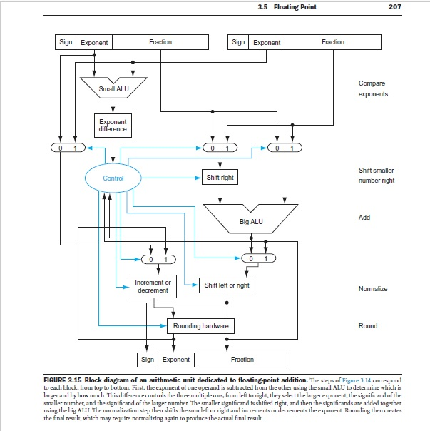

Slide 14
Floating-Point Multiplication
We start by multiplying decimal numbers in scientific notation by hand:
1.110_{ten} x 10¹⁰
x 9.200_{ten} x 10⁻⁵
--------------------------
Assume that we can store only four digits of the significand and two digits of the exponent.
Step 1.
Unlike addition, we calculate the exponent of the product by simply adding the exponents of the operands together:
New exponent 10 + (-5) = 5
Let’s do this with the biased exponents as well to make sure we obtain the same result:
10 ➔10 + 127 = 137, and 5 ➔ -5 + 127 = 122, so
New exponent 137 + 122 = 259, This result is too large for the 8-bit exponent field, so something is amiss! New exponent calculation : (10 + 127) + (-5 + 127) = (5 + 2 x 127) = 259
Remedy: New exponent : 137 + 122 - 127 = 259 - 127 = 132 (i.e, 5 + 127)

Slide 15
Floating-Point Multiplication
Step 2.
Next comes the multiplication of the significands:
1.110_{ten}
× 9.200_{ten}
-----------------------
0000
0000
2220
9990
------------------------
10.212000_{ten}
Step 3. This product is unnormalized, so we need to normalize it:
10.212_{ten} x 10⁵ = 1.0212_{ten} x 10⁶
Step 4. We assumed that the significand is only four digits long (excluding the sign), so we must round the number.
1.0212_{ten} x 10⁶ to 1.021_{ten} x 10⁶
Step 5. The sign of the product depends on the signs of the original operands.
If they are both the same, the sign is positive; otherwise, it’s negative.
Hence, the product is +1.021_{ten} x 10⁶

Slide 16
Floating-Point Instructions in MIPS
MIPS supports the IEEE 754 single precision and double precision formats with these instructions:
Floating-point addition, single (add.s) and addition, double (add.d)
Floating-point subtraction, single (sub.s) and subtraction, double (sub.d)
Floating-point multiplication, single (mul.s) and multiplication, double (mul.d)
Floating-point division, single (div.s) and division, double (div.d)
Floating-point comparison, single (c.x.s) and comparison, double (c.x.d), where x may be equal (eq), not equal (neq), less than (lt), less than or equal (le), greater than (gt), or greater than or equal (ge)
Floating-point branch, true (bc1t) and branch, false (bc1f)
Floating-point comparison sets a bit to true or false (depending on the comparison condition), then
a floating-point branch decides whether or not to branch (depending on the condition)

Slide 17
Compiling a Floating-Point C Program into MIPS
C code
float f2c (float fahr){
return ((5.0/9.0) *(fahr – 32.0));
}
Assume that the fl oating-point argument fahr is passed in $f12 and the result should go in $f0. (Unlike integer registers, floating-point register 0 can contain a number.) What is the MIPS assembly code?

Slide 18
Rounding with Guard Digits
Compute 2.56_{ten} x 10⁰ + 2.34_{ten} x 10² first with guard and round digits, and then without them.
Assuming that we have three significant decimal digits.
Round to the nearest decimal number with three significant decimal digits
Ans.
First, align the exponents, so 2.56_{ten} x 10⁰ becomes 0.0256_{ten} x 10².
Since we have guard and round digits, we are able to represent the two least significant digits when we align exponents.
The guard digit holds 5 and the round digit holds 6.
2.3400_{ten}
+ 0.0256_{ten}
2.3656_{ten}
Thus, the sum is 2.3656_{ten} x 10²
Rounding the sum up with three significant digits yields 2.37_{ten} x 10²

Slide 19
Rounding with Guard Digits
Compute 2.56_{ten} x 10⁰ + 2.34_{ten} x 10² first with guard and round digits, and then without them.
Assuming that we have three significant decimal digits.
Round to the nearest decimal number with three significant decimal digits
Ans.
Second, Doing this without guard and round digits drops two digits from the calculation.
The new sum is then
2.34_{ten}
+ 0.02_{ten}
2.36_{ten}
The answer is 2.36_{ten} x 10²

Slide 20
Fallacies and Pitfalls

Slide 21
Fallacies
Just as a left shift instruction can replace an integer multiply by a power of 2, a right shift is the same as an integer division by a power of 2.
For example, suppose we want to divide -5_{ten} by 4_{ten}; the quotient should be -1_{ten}.
In two’s complement, -5_{ten} = 1111 1111 1111 1111 1111 1111 1111 1011_{two}
Shifting right by two:
0011 1111 1111 1111 1111 1111 1111 1110_{two} ; Is this correct?

Slide 22
Fallacies
Parallel execution strategies that work for integer data types also work for floating-point data types.
Discussion start point:
Programs have typically been written first to run sequentially before being rewritten to run concurrently, so a natural question is, “Do the two versions get the same answer?” If the answer is no, you presume there is a bug in the parallel version that you need to track down.
Hint: since floating-point addition is not associative, the assumption does not hold.

Slide 23
Fallacies
Only theoretical mathematicians care about floating-point accuracy.
A story involving a math professor at Lynchburg College in Virginia, Thomas Nicely, discovered a bug in floating point division algorithm discovered by Intel in September 1994.
Intel claimed that the bug will affect only the average spreadsheet user once in 27000 years.
But, soon IBM Research claimed that the bug will affect such a user every 24 days.
Intel was then forced to offer a free exchange of their existing processer with an updated processor that corrects the flaw

Slide 24
Pitfalls
Floating-point addition is not associative.
Problems occur when adding two large numbers of opposite signs plus a small number.
For example, let’s see if c + (a + b) = (c + a) + b.
Assume a, b and c are single precision numbers and c = -1.5_{ten} x 10³⁸, a = 1.5_{ten} x 10³⁸, and b = 1.0
c + (a + b) = -1.5_{ten} x 10³⁸ + (1.5_{ten} x 10³⁸ + 1.0) = -1.5_{ten} x 10³⁸ + 1.5_{ten} x 10³⁸ = 0
(c + a) + b = (-1.5_{ten} x 10³⁸ + 1.5_{ten} x 10³⁸ ) + 1.0 = 0.0 + 1.0 = 1.0

Slide 25
Pitfalls
The MIPS instruction add immediate unsigned (addiu) sign-extends its 16-bit immediate field.
MIPS has no subtract immediate instruction, and negative numbers need sign extension, so the MIPS architects decided to sign-extend the immediate field.

Slide 26


